Slide 1

Project Review-2
on
Public Financing through Decentralized Application
by Shreyansh P. Dixit (RA19004010172)
Shivanshu Tripathi (RA19004010178)
Prashant Darshan (RA19004010185)
Under the guidance of
Dr. S. Latha
Assistant Professor, Department of ECE

Slide 2
INDEX
Abstract
Objectives
Problem Statement
Literature Survey
Novelty
Architecture Diagram
Design Methodology / Approach
Software specifications
Research Progress
Work Plan
Output
Requirements and Proposed Budget
Applications
Conclusions
References

Slide 3
ABSTRACT
People’s data is valuable and sensitive, and blockchain can significantly change how it is seen. All transactions are real time and are logged irreversible.
While making such transactions, privacy and security of an individual is paramount for the service provider
Using machine learning in web application, projects of more importance like education and health will be pushed up above other projects.
This will be a multi user application. The user can see all the listed projects with all critical information being reflected on the website.

Slide 4
OBJECTIVE
To make a secure, transparent and decentralised web application.
To keep identity of donator private in order to avoid his/her exposure to scammer.
To demonstrate cryptocurrency transactions are safe, secure and less hectic then general payment methods, no KYC to be done.
To develop website using recent web3 technologies.

Slide 5
PROBLEM STATEMENT
People’s data is valuable and sensitive, and blockchain can significantly change how it is seen.
While making transactions, privacy and security of an individual is paramount for the service provider.
The number of procedure and paper work to be done by banks before making a bank account is a headache for people.

Slide 6
Literature Survey
AUTHOR | PAPER | CONTRIBUTION | INFERENCE
[1] L.Cao [2022] IEEE Intellignt systems | Decentralized AI: Edge Intelligence and Smart Blockchain, Metaverse, Web3, and DeSci | -Smart contracts that can securely, fault and risk-tolerantly and automatically codify, transfer, execute, audit, and manage cryptographically - Web3 is deemed to be a new edition of the World Wide Web enabled by decentralized blockchain technology | -Integrating blockchain based transaction methods to ease the procedure for donators. -Smart contracts can detect frauds and mischiefs instantaneously. Thus, financial security can be ensured.
[2] ZIBIN ZHENG [2022] IEEE Open Journal of the Computer Society | When Digital Economy Meets Web3.0: Applications and Challenges | -Cryptography becomes an essential requirement for blockchain to safeguard user transaction information and privacy alongside ensuring data consistency. -Distributed storage is based on blockchain technology that uses open source applications | - There will be no SQL/NoSQL database to store transaction information. - Metamask, a decentralised wallet to be used for transaction purposes.

Slide 7
Literature Survey
AUTHOR | PAPER | CONTRIBUTION | INFERENCE
[3] U. Majeed [2023] IEEE Access | FL-Incentivizer: FL-NFT and FL-Tokens for Federated Learning Model Trading and Training | -Unlike centralized applications, Decentralized Applications (DApps) do not have a single administrator or controller. -Modern DApps are self-governing applications and are composed of a front end interface, an application programming interface (API), and a back-end. | -Dapp are more transparent and stable than a centralized application
[4] V. Y. Kemmoe [2020] IEEE Access | Recent Advances in Smart Contracts: A Technical Overview and State of the Art | -Smart contracts, which are computer programs that replicate the actions described in physical/traditional contracts -Objective of smart contract are : observability, verifiability, privity, and enforceability | - Using smart contract, transaction can be automated and authenticity can be verified.
[5] M. N. M. Bhutta [2021] IEEE Access | A Survey on Blockchain Technology: Evolution, Architecture and Security | Ethereum has been developed as open-source public Blockchain platform to implement Dapp. It facilitates users to develop fairly complex applications of different capabilities to perform arbitrary operations | The account type used is Ethereum.

Slide 8
NOVELTY
The application is made using Web3 technologies
There is no database to store the transaction
No threat to donator’s identity as wallet ID is shown to public. Thus, better data privacy
An individual can track progress of a campaign before deciding to make a contribution

Slide 9
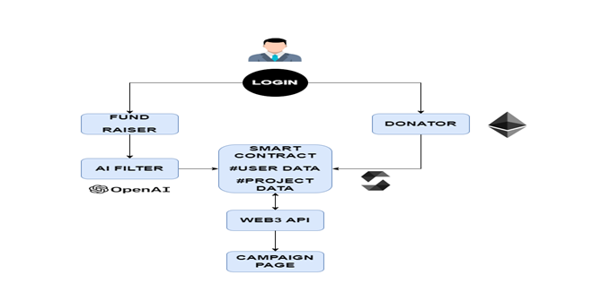
System/Architecture diagram (PROPOSED)
Fig. 1: System architecture

Slide 10
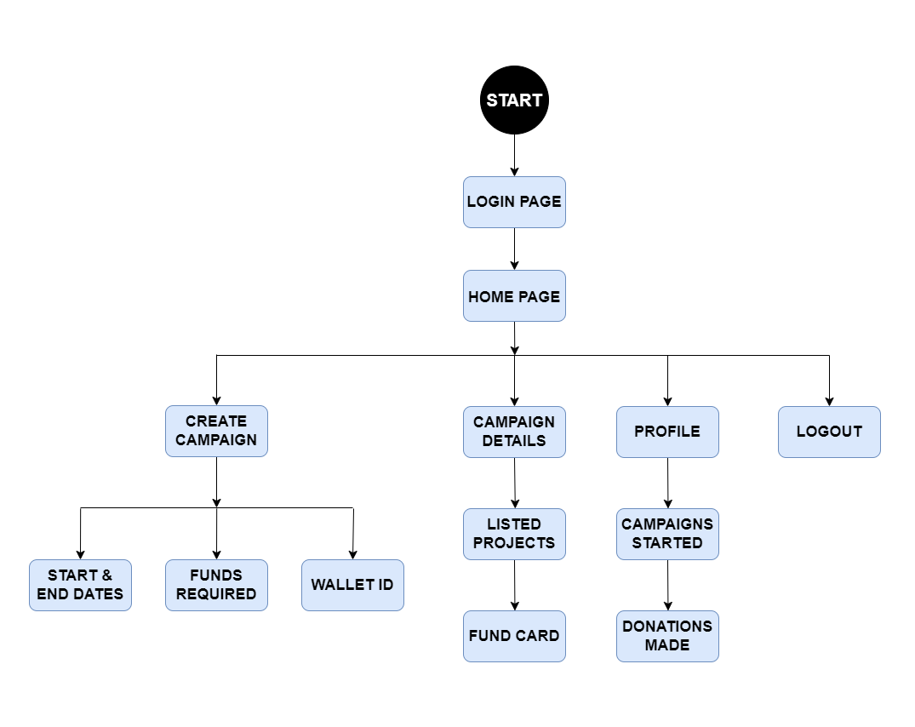
Fig.2: Flow Diagram

Slide 11
SOFTWARE SPECIFICATION
IDE: Vscode, Hardhat, Jupyter
Programming Language used: Javascript, Solidity, Python
Framework used: React.js
Software packaging system: Yarn

Slide 12
RESEARCH PROGRESS
Till now, frontend and back-end of the project is developed using web3 technologies which accounts for ~90% of the project.
The user interface is made ready which includes navigation bar, profile, campaign page, home page, payment page.
The Smart contraction is developed.

Slide 13
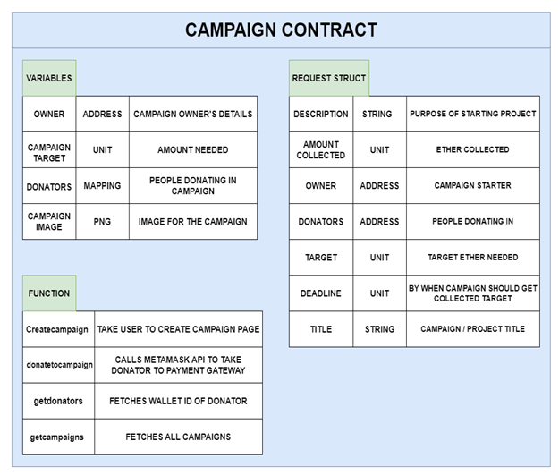
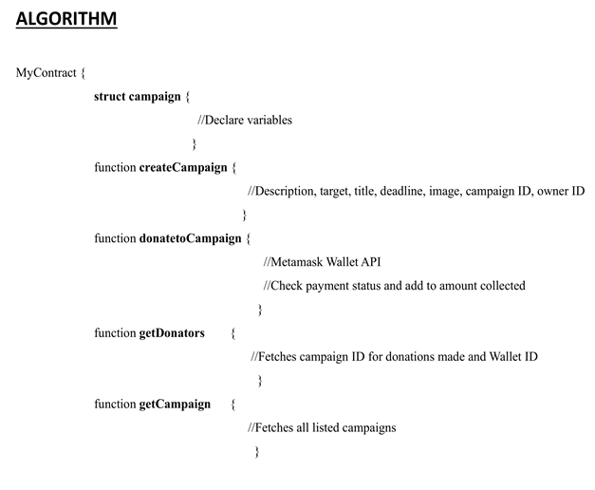
SMART CONTRACT
Fig. Structure of Campaign Contract
Fig. Smart Contract algorithm

Slide 14
WORK PLAN
Phase 1
Front-end of the website will be developed
Phase 2
Back-end will be developed and integrated with front-end
Phase 3
Dapp will be deployed on internet for public reach

Slide 15
WORK PROGRESS
Front-end and back-end of the project is developed
Smart contract is now ready to use in the backend to automate the transaction.
All web pages are interlinked.
90% of the work is done.

Slide 16
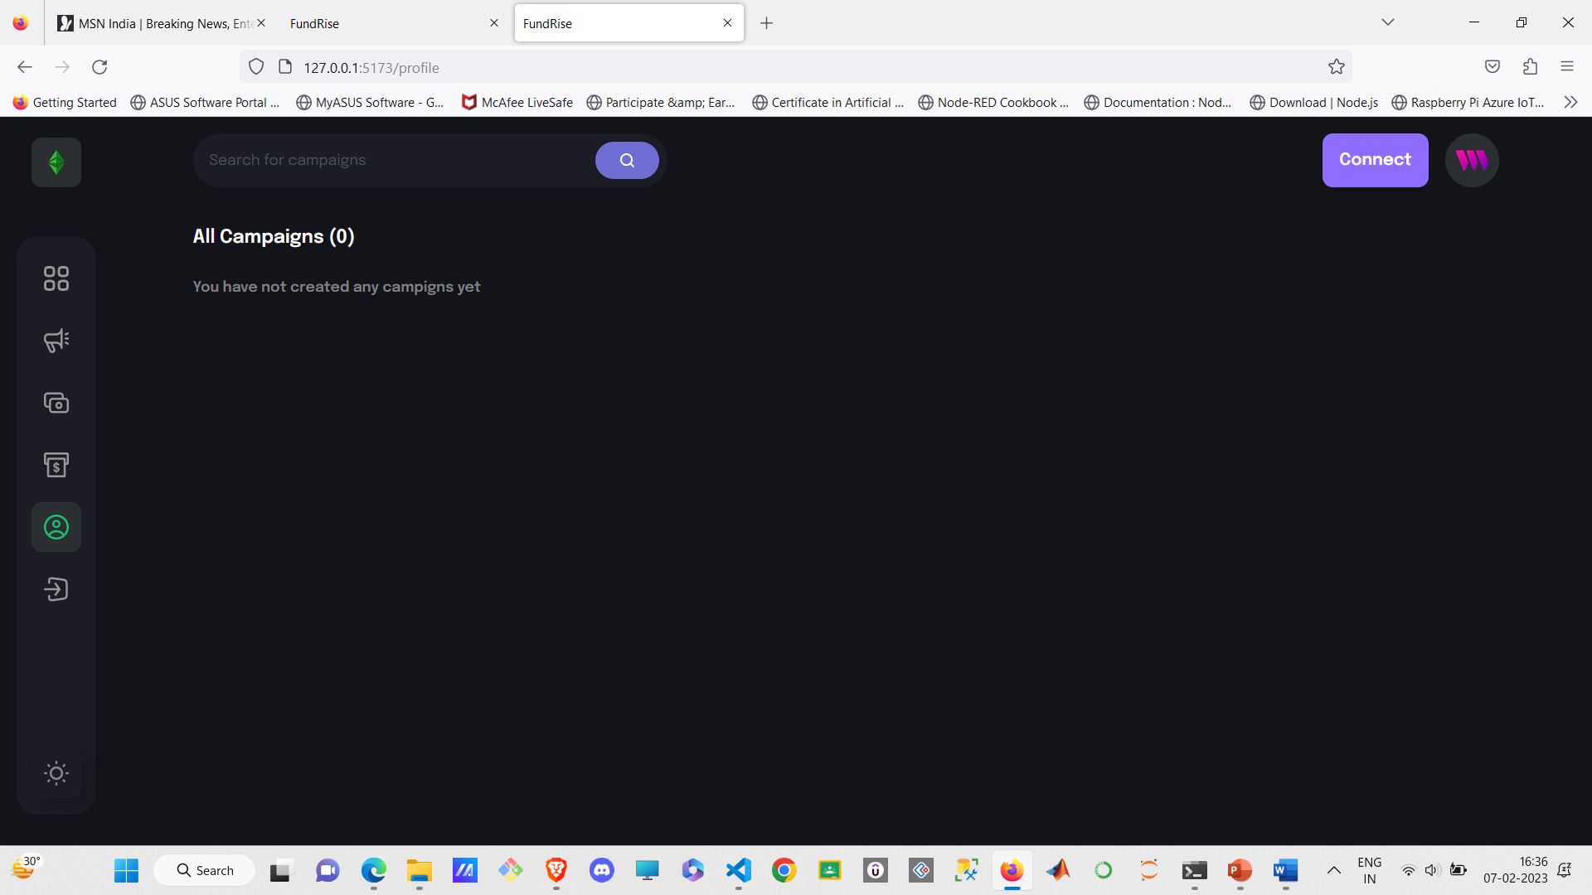
Output
Fig. 3: Home Page

Slide 17
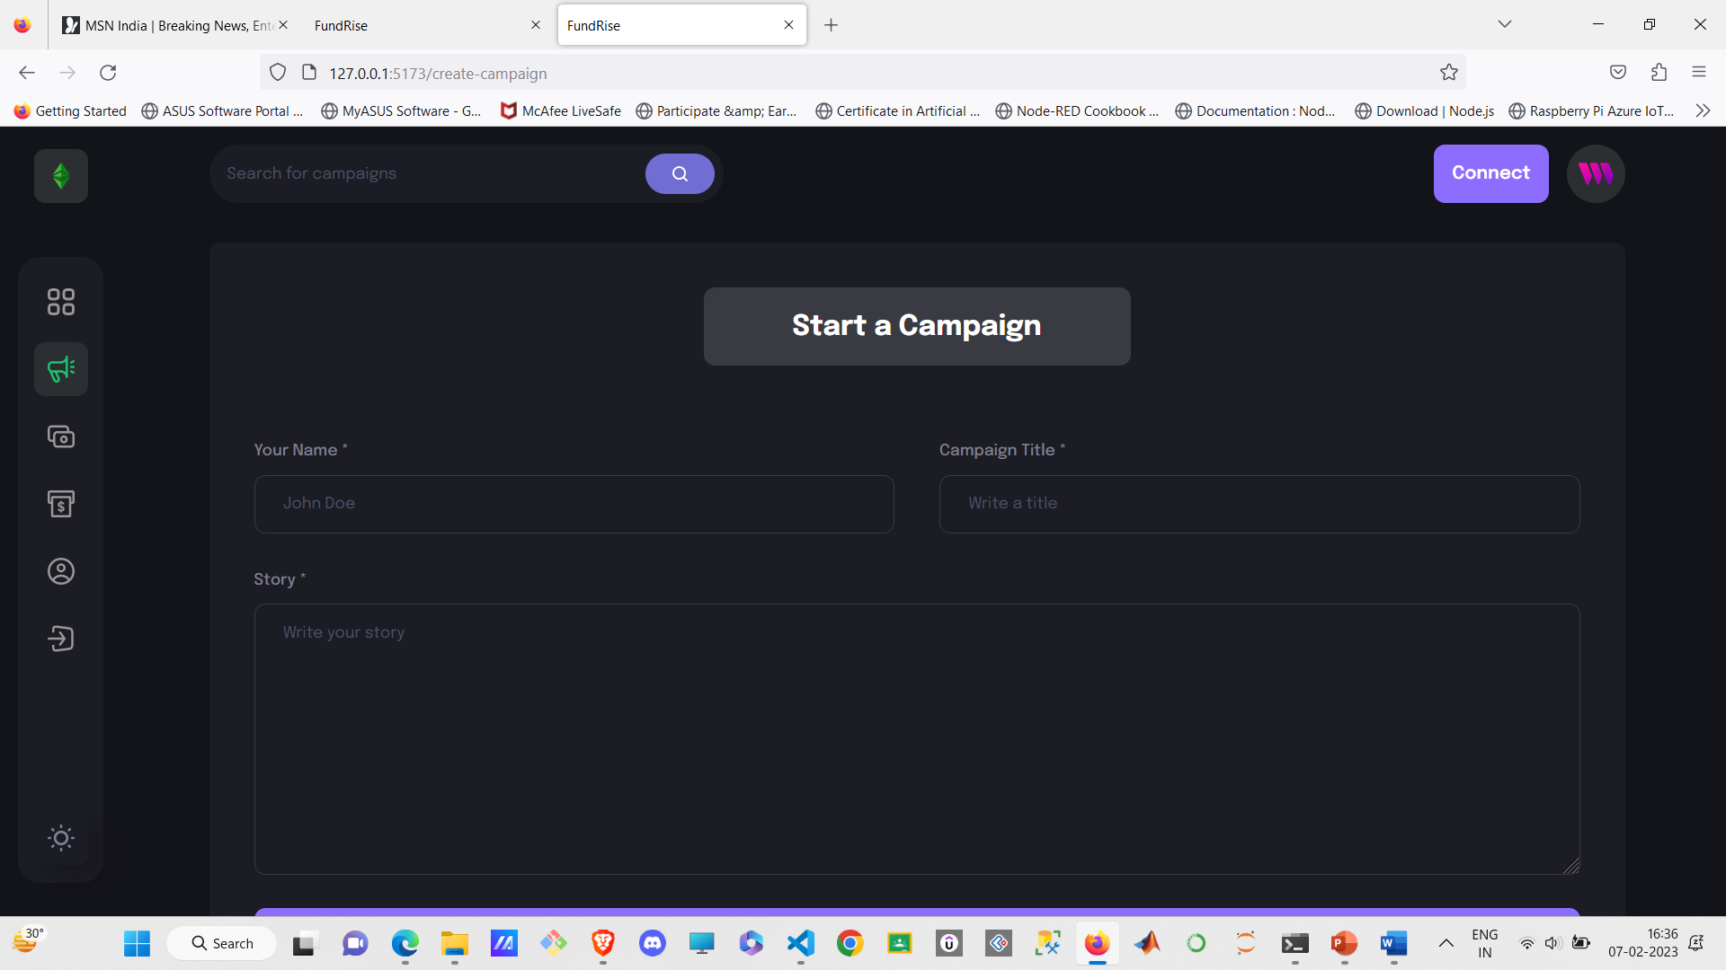
Output
Fig. 4: Campaign Create Page

Slide 18
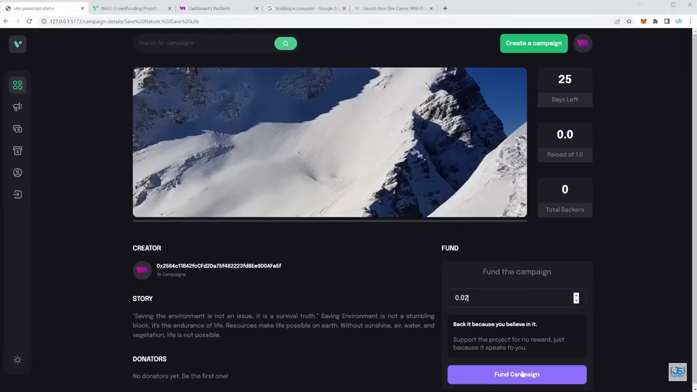
Output
Fig. 4: Campaign Page

Slide 19
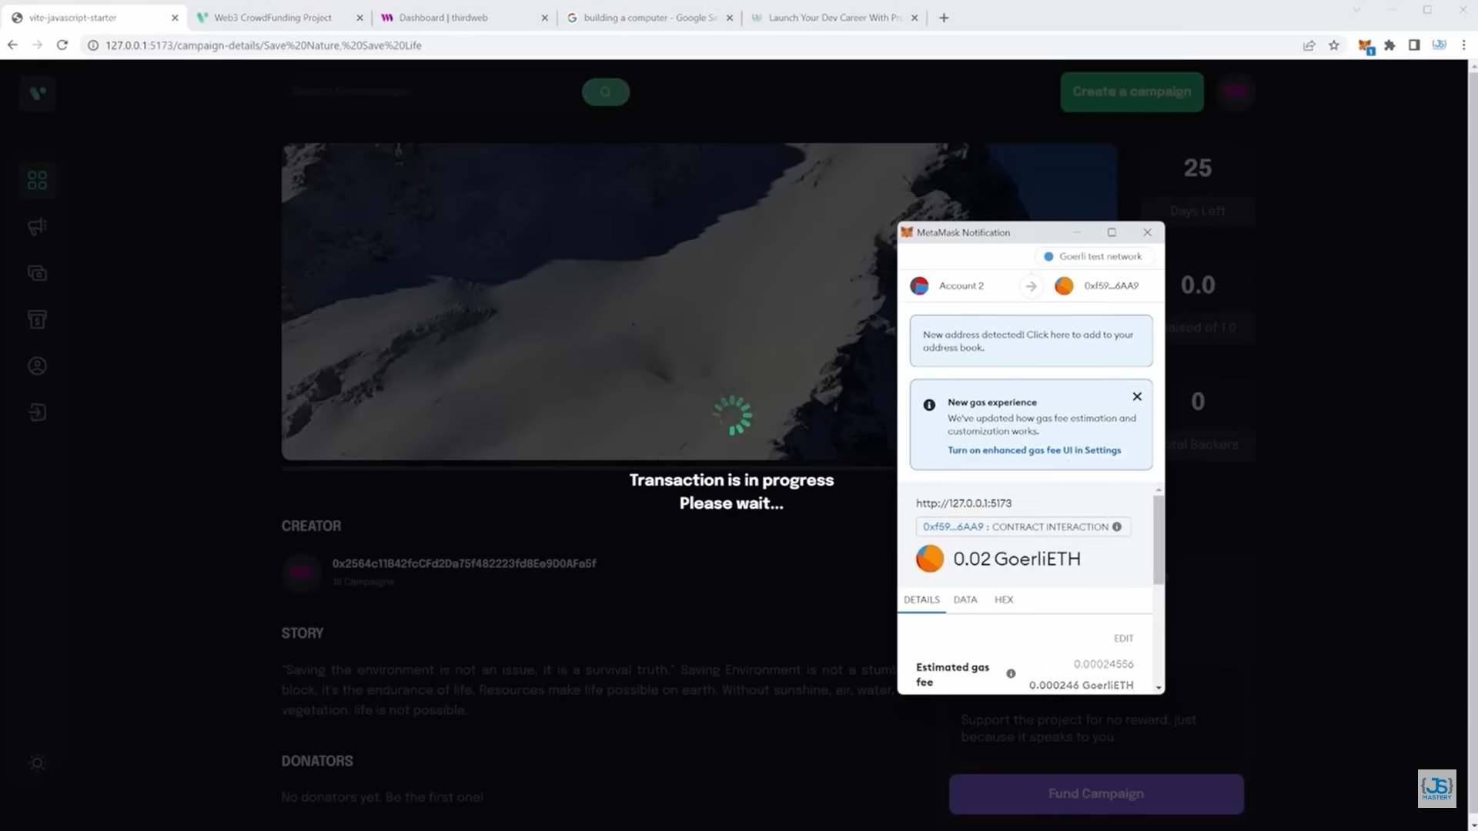
Output
Fig. 4: Transaction interface

Slide 20
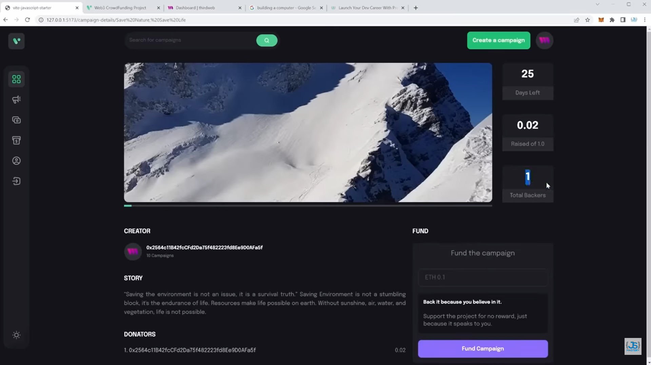
Output
Fig. 4: Succesful Transaction

Slide 21
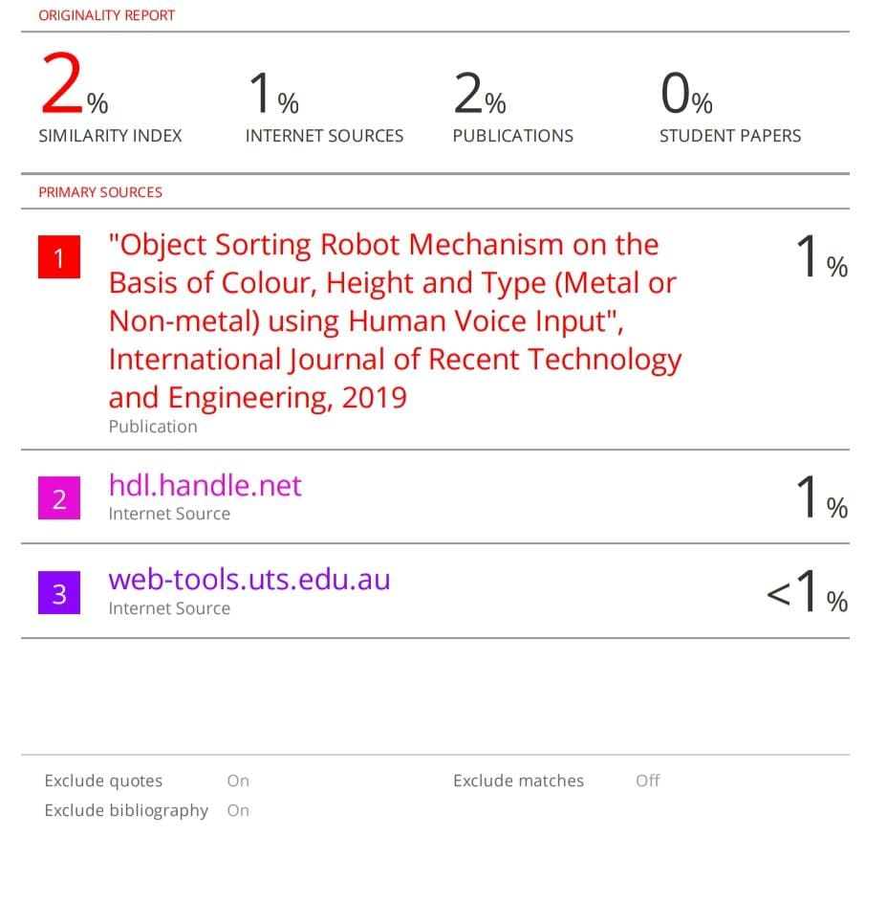
Plagiarism Report
Fig. 4: Plagiarism report

Slide 22
BUDGET
As the project is made using Opensource software, the front end and backend will not cost money
The deployment will cost us $10 which is roughly ₹800/-. Thus total project cost will be ₹800/-

Slide 23
APPLICATION
Integration of web3 technologies can be done for all modern website, as demonstrated.
The smart contracts which will be developed can be used for transaction automation through blockchain for any web application eg. School/college fees collection, ticket booking counter etc.

Slide 24
CONCLUSION
The application ensures that the funds are transferred in proper proportion through the smart contract to the Campaign owner’s account upon completion of the milestones
Privacy and security of every user is ensured
Students and patients get easy access to world and could raise money quickly in crypto currency

Slide 25
FUTURE WORK
AI can be integrated in the project to push a more urgent and important campaigns based on cause and engagement of public
With passage of time, payment methods needs to be updated to make it more secure
Smart contract can be improved with more futuristic protocols
Project can be extended to include NFT transactions

Slide 26
REFERENCES
L. Cao, "Decentralized AI: Edge Intelligence and Smart Blockchain, Metaverse, Web3, and DeSci," in IEEE Intelligent Systems, vol. 37, no. 3, pp. 6-19, 1 May-June 2022, doi: 10.1109/MIS.2022.3181504.
C. Chen et al., "When Digital Economy Meets Web3.0: Applications and Challenges," in IEEE Open Journal of the Computer Society, vol. 3, pp. 233-245, 2022, doi: 10.1109/OJCS.2022.3217565.
U. Majeed, L. U. Khan, S. S. Hassan, Z. Han and C. S. Hong, "FL-Incentivizer: FL-NFT and FL-Tokens for Federated Learning Model Trading and Training," in IEEE Access, vol. 11, pp. 4381-4399, 2023, doi: 10.1109/ACCESS.2023.3235484.
V. Y. Kemmoe, W. Stone, J. Kim, D. Kim and J. Son, "Recent Advances in Smart Contracts: A Technical Overview and State of the Art," in IEEE Access, vol. 8, pp. 117782-117801, 2020, doi: 10.1109/ACCESS.2020.3005020.
M. N. M. Bhutta et al., "A Survey on Blockchain Technology: Evolution, Architecture and Security," in IEEE Access, vol. 9, pp. 61048-61073, 2021, doi: 10.1109/ACCESS.2021.3072849.

